Slide 1
Terraform Best Practices
Pinal Dave
https://www.linkedin.com/in/pinal-dave/

Slide 2
The scenario : Create the following resources using Terraform:
An S3 bucket
An IAM role
An IAM policy attached to the role that allows it to perform any S3 actions on that bucket and the objects in it
An EC2 instance with the IAM role attached
Output the public IP of the EC2 instance and the S3 bucket name.

Slide 3
Most common mistakes developers make while scripting infrastructure using Terraform
Hardcoding secrets in the terraform config file
Hardcoding important infrastructure items like regions, subnet address space and other dynamic items in terraform config file
Put everything in one large config file, making it hard to read and modify
Reinventing the wheel, not using the modules
Improper naming convention
Storing state locally
Not using version control system

Slide 4
Best Practice - 1: Never hardcode credentials in terraform config files
Use environment variables
Use a secure vault to store your credential like AWS KMS, Azure Key Vault or Terraform Vault
AWS CLI / Shared credential file
Instance Profile

Slide 5
Organize config into sections
Main Config
Output
Resources
Var files

Slide 6
Best Practice – 2 : Use Remote State File
State is stored locally by default
Never store terraform state file locally to safeguard state data
Security store state file remotely in a reliable storage to enable team collaboration
Use locking mechanism to avoid concurrent changes in the state file

Slide 7
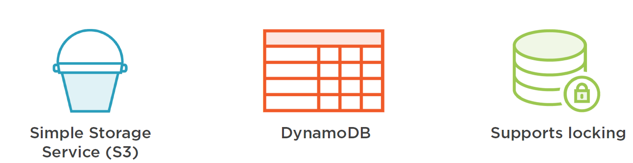
AWS Storage for Remote State
Image Courtesy : Pluralsight

Slide 8
Terraform Workspace
Use Terraform workspace to store common configuration
It separate state data
Enable use of multiple environments

Slide 9
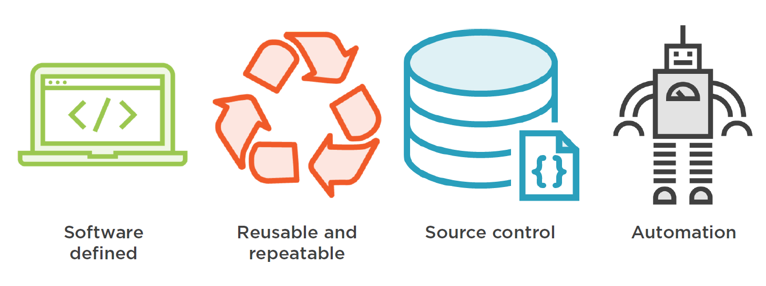
Use Source Control Management
Image Courtesy : Pluralsight

Slide 10
Source Control Management Cont..
Git, TFS, Subversion
Enable collaboration
Version controlled
Use best practices on branching & merging, pull/push

Slide 11
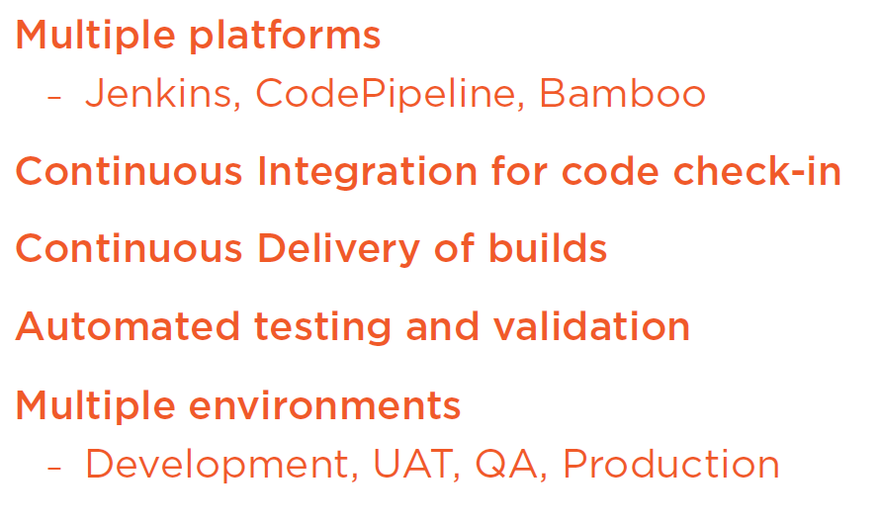
Automation: CI/CD Pipelines

Slide 12
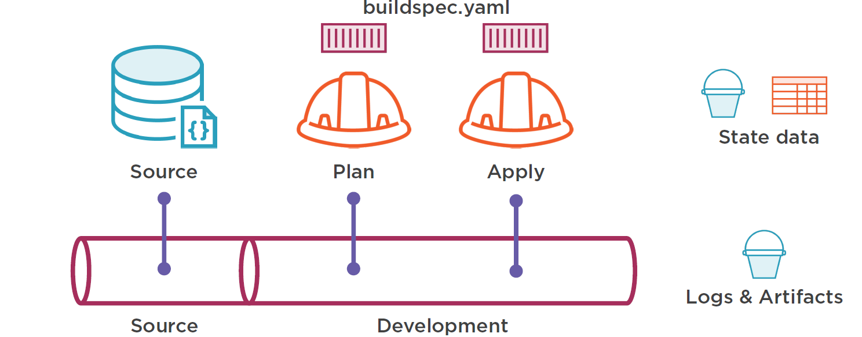
CI/CD Pipelines Cont…
Image Courtesy : Pluralsight

